Slide 1
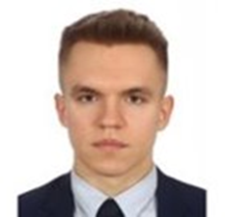
Michał Dziechciarz
225484
[photo]
Learning Log
2023/24 Block A
Design by Marvin Damstra

Slide 2

How To Use
This Template
As a student at Breda University of Applied Sciences studying to become a professional, you are required to provide evidence that demonstrates your professional learning and growth during the block. This template is intended to provide you with a well-structured and organised format for doing this effectively. Keep in mind that certain competencies may require you to update your evidence every week, and others may have only be relevant during a particular week or two.
With the evidence you present here teachers should get a clear and comprehensive overview of your progress, how you’ve engaged with feedback, as well as your general attitude and performance as a student and as an aspiring professional developer.
Note that number and size of text boxes and how they are organized on each slide may be modified as needed. It is up to you to decide what layout is most effective for the content you are providing. You may also add slides if needed, but try to be as economical as possible, i.e. quality over quantity. Focus on the things that are the most significant and meaningful.
You are also free to stylise this template to improve the graphic design and visual appeal, but please remember its purpose: to provide evidence of your progress towards becoming a professional developer. Changes should only enhance and extend the information, and may never subtract. I.e. do not delete anything or change the order of things. If in doubt, seek approval from your teachers!

Slide 3
Learning Log
Structure
Section A - My Plan Must be completed in week 1
Your plan describes your goals for the block. Starting with where you are right now, where do you want to be at the end of the block? I.e. what role(s) will you take responsibility for, and how will you demonstrate progress relevant to the ILOs for this block? What tasks and deliverables are best aligned with your role and the project brief?
Section B - ILO’s Must be completed in week 8 but should be updated regularly
This is where you link your evidence to each of the Intended Learning Outcomes of this block.
Section B - Weekly Log Must be updated every week
This is simply a log (journal) of what you do each day, and what you learn from it. It is your responsibility to update this regularly and frequently. Be sure to include working links to any specific evidence you are referencing (and make sure that you share your docs with the teaching team). Note: some of the required information may be captured in production documents such as your work log or peer reviews.
In such cases, you simply need to provide links to those artifacts and may include any explanatory comment or reflection you feel is appropriate.
(Some reflection is almost always a good idea as it provides the foundation for Section C.)
Section C - Reflection Must be completed in week 8
Summative reflection on your progress during the block including a critical assessment of everything you did and learned during the block. This is a comprehensive review of everything recorded in Section B, evaluated against the goals and planning laid out in Section A.
Section A
Starting this block
Goals
Section B
ILO section
Week log section
Section C
Block reflection

Slide 4
Section A
The student sets ambitious, S.M.A.R.T./ C.L.E.A.R goals in alignment with the project brief, their chosen role(s), content of the assessment rubric and their personal long-term goals
A
Goal Setting
Notes:
MUST BE UPDATED EVERY WEEK
This is simply a log (journal) of what you do each day, and what you learn from it. It is your responsibility to update this regularly and frequently. Be sure to include working links to any specific evidence you are referencing (and make sure that you share your docs with the teaching team). Note: some of the required information may be captured in production documents such as your work log or peer reviews.
In such cases, you simply need to provide links to those artifacts and may include any explanatory comment or reflection you feel is appropriate.
(Some reflection is almost always a good idea as it provides the foundation for Section C.)

Slide 5
A
Where am I starting?
1/2
Feedback from previous assessment
Previous block’s grade
9.9
"Great work Michal! You have the highest peer review score, this is a big achievement. Keep at it."
My interpretation / key takeaways
I am quite a good teammate and should constantly keep trying to improve.
Notes:
Copy and paste the feedback from the previous block’s assessment into the text box.
Copy and paste the bullet points you listed on the “Lessons Learned” page in section C of your last block’s log.
Compare the grade you gave yourself with the grade you received, and reevaluate or restate your feeling on your current level of progress.

Slide 6
A
What is my plan?
2/2
What I learned last block
Previous block’s grade
9.9
I should try to be more direct when communicating with my teammates, especially when problems arise.
My current level of progress
I am less worried about speaking up within the team
Notes:
Copy and paste the feedback from the previous block’s assessment into the text box.
Copy and paste the bullet points you listed on the “Lessons Learned” page in section C of your last block’s log.
Compare the grade you gave yourself with the grade you received, and reevaluate or restate your feeling on your current level of progress.

Slide 7
A
What are my goals?
2/2
S | Specific: Be specific when determining your goal. The more specific the better. Putting a real figure to your goal helps make it measurable. When specific and measurable your subconscious mind cannot override your goals, they become achievable.
M | Meaningful: This is the WHY of your goal setting. When your specific goal has enough meaning for you, you will do whatever it takes to achieve it. When your goal is meaningful the more profound and life altering the results are.
A | Achievable: Choosing realistic and short-term goals helps them be more achievable. Long-term goals can be larger and take more time to achieve. Planning smaller short-term goals as steps to larger long-term goals assists in achieving them.
R | Relevant: Each goal you set must be in line with your core values and in harmony with what YOU want out of life. Contradictions in values and goals leads to frustration and loss of motivation. Designing your goals with the expectation of your personal success.
T | Time-Bound: Setting a time limit on achieving a goal makes it measurable. When a goal is measurable you can SEE your progress and support your motivation and commitment. Giving your goal a time limit assists you in holding yourself accountable to its completion.
E | Evaluate: By evaluating your goals on a regular basis you will be much more likely to achieve them. It is easy to forget about long-term goals if they are not revisited from time to time. This also helps you assess if the goal you are working on remains in line with your core values and helps you measure your progress.
R | Readjust: Readjustments occur when goals are determined, through re-evaluation, to be misaligned with your values or long-term goals. This is especially helpful when you have been unable to achieve a goal in the time limits you set. This gives you the opportunity to modify your approach and increase your chances of success.
Goal: Finish the Research Methods course by the end of week 2 (17 Sep)
Specific: My goal is to finish the Research Methods course by the end of week 2. This means completing all the coursework, assignments, and assessments for the course within that time frame.
Meaningful: Completing the Research Methods course is important as it will enhance my research skills and knowledge in my field of study. It will enable me to understand and apply different research methodologies effectively.
Achievable: Finishing the course within two weeks is achievable as it provides a reasonable amount of time to complete the required tasks and meet the course requirements.
Relevant: This goal is relevant to this block's project as conducting research lies its foundation.
Time-bound: I have set a clear deadline of the end of week 2 to complete the course, which provides a specific timeframe to work towards.
Notes:
Describe your goals for this block using the SMARTER method. Make sure they are clear, relevant, have a measurable outcome, and can be recorded. Consider how well do they align with the role(s) you wish to take, and with the requirements given in the project brief. Think about the objectives you plan to choose, or that are mandated by the project. Are there any competencies that you need to focus on?
For each goal, find concrete examples of tasks you expect to undertake that will demonstrate this within the project for the block. Make sure the plan has an outcome that can be tracked and assessed. Make sure you have a clearly stated target for each goal. If you are unsure of how to demonstrate something, ask for help from your teachers.

Slide 8
A
What are my goals?
2/2
S | Specific: Be specific when determining your goal. The more specific the better. Putting a real figure to your goal helps make it measurable. When specific and measurable your subconscious mind cannot override your goals, they become achievable.
M | Meaningful: This is the WHY of your goal setting. When your specific goal has enough meaning for you, you will do whatever it takes to achieve it. When your goal is meaningful the more profound and life altering the results are.
A | Achievable: Choosing realistic and short-term goals helps them be more achievable. Long-term goals can be larger and take more time to achieve. Planning smaller short-term goals as steps to larger long-term goals assists in achieving them.
R | Relevant: Each goal you set must be in line with your core values and in harmony with what YOU want out of life. Contradictions in values and goals leads to frustration and loss of motivation. Designing your goals with the expectation of your personal success.
T | Time-Bound: Setting a time limit on achieving a goal makes it measurable. When a goal is measurable you can SEE your progress and support your motivation and commitment. Giving your goal a time limit assists you in holding yourself accountable to its completion.
E | Evaluate: By evaluating your goals on a regular basis you will be much more likely to achieve them. It is easy to forget about long-term goals if they are not revisited from time to time. This also helps you assess if the goal you are working on remains in line with your core values and helps you measure your progress.
R | Readjust: Readjustments occur when goals are determined, through re-evaluation, to be misaligned with your values or long-term goals. This is especially helpful when you have been unable to achieve a goal in the time limits you set. This gives you the opportunity to modify your approach and increase your chances of success.
Goal: Finish the Writing in the Sciences course by the end of week 3 (24 sep)
Specific: This entails completing all the course content, assignments, and assessments within the given time frame.
Meaningful: Completing the Writing in the Sciences course is meaningful as it will improve my scientific writing skills.
Achievable: Finishing the course within three weeks is achievable as it allows for sufficient time to work through the course materials.
Relevant: This goal is relevant to my academic and professional pursuits as it will contribute to my ability to write a good research paper.
Time-bound: I have set a specific deadline of the end of week 3 to complete the Writing in the Sciences course, providing a clear timeframe within which to achieve this goal.
Notes:
Describe your goals for this block using the SMARTER method. Make sure they are clear, relevant, have a measurable outcome, and can be recorded. Consider how well do they align with the role(s) you wish to take, and with the requirements given in the project brief. Think about the objectives you plan to choose, or that are mandated by the project. Are there any competencies that you need to focus on?
For each goal, find concrete examples of tasks you expect to undertake that will demonstrate this within the project for the block. Make sure the plan has an outcome that can be tracked and assessed. Make sure you have a clearly stated target for each goal. If you are unsure of how to demonstrate something, ask for help from your teachers.

Slide 9
A
What are my goals?
2/2
S | Specific: Be specific when determining your goal. The more specific the better. Putting a real figure to your goal helps make it measurable. When specific and measurable your subconscious mind cannot override your goals, they become achievable.
M | Meaningful: This is the WHY of your goal setting. When your specific goal has enough meaning for you, you will do whatever it takes to achieve it. When your goal is meaningful the more profound and life altering the results are.
A | Achievable: Choosing realistic and short-term goals helps them be more achievable. Long-term goals can be larger and take more time to achieve. Planning smaller short-term goals as steps to larger long-term goals assists in achieving them.
R | Relevant: Each goal you set must be in line with your core values and in harmony with what YOU want out of life. Contradictions in values and goals leads to frustration and loss of motivation. Designing your goals with the expectation of your personal success.
T | Time-Bound: Setting a time limit on achieving a goal makes it measurable. When a goal is measurable you can SEE your progress and support your motivation and commitment. Giving your goal a time limit assists you in holding yourself accountable to its completion.
E | Evaluate: By evaluating your goals on a regular basis you will be much more likely to achieve them. It is easy to forget about long-term goals if they are not revisited from time to time. This also helps you assess if the goal you are working on remains in line with your core values and helps you measure your progress.
R | Readjust: Readjustments occur when goals are determined, through re-evaluation, to be misaligned with your values or long-term goals. This is especially helpful when you have been unable to achieve a goal in the time limits you set. This gives you the opportunity to modify your approach and increase your chances of success.
Goal: Study Dutch vocabulary daily for at least 10 minutes till the end of the block (03 Nov)
Specific: The goal is clearly defined and focused on studying Dutch vocabulary daily for at least 10 minutes.
Meaningful: The goal is meaningful as the ability to speak Dutch will be essential if I decide to stay to live in Netherlands.
Achievable: The goal is achievable as it requires only 10 minutes of daily study, which is a manageable and realistic commitment.
Relevant: The goal is relevant because it aligns with my life goals, one of which is becoming a polyglot.
Time-bound: The goal is time-bound as there is a clear deadline mentioned - till the end of the block - 3rd of November.
Notes:
Describe your goals for this block using the SMARTER method. Make sure they are clear, relevant, have a measurable outcome, and can be recorded. Consider how well do they align with the role(s) you wish to take, and with the requirements given in the project brief. Think about the objectives you plan to choose, or that are mandated by the project. Are there any competencies that you need to focus on?
For each goal, find concrete examples of tasks you expect to undertake that will demonstrate this within the project for the block. Make sure the plan has an outcome that can be tracked and assessed. Make sure you have a clearly stated target for each goal. If you are unsure of how to demonstrate something, ask for help from your teachers.

Slide 10
A
What are my goals?
2/2
S | Specific: Be specific when determining your goal. The more specific the better. Putting a real figure to your goal helps make it measurable. When specific and measurable your subconscious mind cannot override your goals, they become achievable.
M | Meaningful: This is the WHY of your goal setting. When your specific goal has enough meaning for you, you will do whatever it takes to achieve it. When your goal is meaningful the more profound and life altering the results are.
A | Achievable: Choosing realistic and short-term goals helps them be more achievable. Long-term goals can be larger and take more time to achieve. Planning smaller short-term goals as steps to larger long-term goals assists in achieving them.
R | Relevant: Each goal you set must be in line with your core values and in harmony with what YOU want out of life. Contradictions in values and goals leads to frustration and loss of motivation. Designing your goals with the expectation of your personal success.
T | Time-Bound: Setting a time limit on achieving a goal makes it measurable. When a goal is measurable you can SEE your progress and support your motivation and commitment. Giving your goal a time limit assists you in holding yourself accountable to its completion.
E | Evaluate: By evaluating your goals on a regular basis you will be much more likely to achieve them. It is easy to forget about long-term goals if they are not revisited from time to time. This also helps you assess if the goal you are working on remains in line with your core values and helps you measure your progress.
R | Readjust: Readjustments occur when goals are determined, through re-evaluation, to be misaligned with your values or long-term goals. This is especially helpful when you have been unable to achieve a goal in the time limits you set. This gives you the opportunity to modify your approach and increase your chances of success.
Goal: Finish the research paper up to the Methods section by the end of week 6
Specific: My goal is to finish the research paper up to the Methods section by the end of week 6. This involves completing all the sections such as the Introduction, Literature Review, Hypotheses, and the subsections: Participants, Materials, Design, Procedure.
Meaningful: Completing the research paper up to the Methods section by week 6 is meaningful it will reassure me that I'm progressing at a good pace and make me feel comfortable.
Achievable: Finishing the research paper up to the Methods section within six weeks is achievable as it allows for adequate time to conduct research, gather data, analyze findings, and write the necessary sections.
Relevant: This goal is relevant as it focuses on the main deliverable of the entire block's project.
Time-bound: I have set a clear deadline of the end of week 6.
Notes:
Describe your goals for this block using the SMARTER method. Make sure they are clear, relevant, have a measurable outcome, and can be recorded. Consider how well do they align with the role(s) you wish to take, and with the requirements given in the project brief. Think about the objectives you plan to choose, or that are mandated by the project. Are there any competencies that you need to focus on?
For each goal, find concrete examples of tasks you expect to undertake that will demonstrate this within the project for the block. Make sure the plan has an outcome that can be tracked and assessed. Make sure you have a clearly stated target for each goal. If you are unsure of how to demonstrate something, ask for help from your teachers.

Slide 11
Section B
B
Progress Log
Notes:
MUST BE UPDATED EVERY WEEK
This is simply a log (journal) of what you do each day, and what you learn from it. It is your responsibility to update this regularly and frequently. Be sure to include working links to any specific evidence you are referencing (and make sure that you share your docs with the teaching team). Note: some of the required information may be captured in production documents such as your work log or peer reviews.
In such cases, you simply need to provide links to those artifacts and may include any explanatory comment or reflection you feel is appropriate.
(Some reflection is almost always a good idea as it provides the foundation for Section C.)

Slide 12
1
Week 1 - Log
1/2
Reflection
How did the week go? This was a relatively good week, however, it is only the first week of the school year so I can't say much about it. My focus was directed a bit more towards building good team dynamics and getting used to the working routine rather than study material only.
What went well? The integration with my team went very smoothly and I could feel comfortable working with them very quickly.
What didn’t go so well? I was a bit confused and had difficulties understanding how should I perform my research, where to start and what the end goal should look like.
What did you learn? After this week, I have some clearer idea what exactly a research is and how it should be conducted.
What could be added as an Action point looking forward to next week? - To finish the literature review and create a summary - Prepare for the creation of the preliminary research design - Finish the Research Methods course

Slide 13
1
Week 1 - Feedback
2/2
Team, individual, peer, workshop feedback
[Reviewer] Feedback
Response to Feedback

Slide 14
2
Week 2 - Log
1/2
What did you do?
Reflection
What goal(s) did you set for this week? - To finish the literature review and create a summary - Prepare for the creation of the preliminary research design - Finish the Research Methods course
What have you actually been able to do? I have finished the "Understanding Research Methods" course as planned. I have written a summary of my literature review and presented it to the team.
How did the week go? The week went well overall. I was able to accomplish a lot of tasks and make progress on my literature review.
What went well? - I successfully completed the significant part of my literature review on AI in the sports industry. I found several relevant sources and was able to extract valuable information from them.
What didn’t go so well? - I had some difficulty managing my time effectively. I found myself getting distracted and taking longer than expected to complete tasks.
What did you learn? I have gained a good understanding of how AI is being applied to the sports industry and sports event management, which I had no idea about before. Also the example research paper from Myrthe gave my some clarification on how to write my own research paper.
What could be added as an Action point looking forward to next week? - Finish the "Writing in the Sciences" course

Slide 15
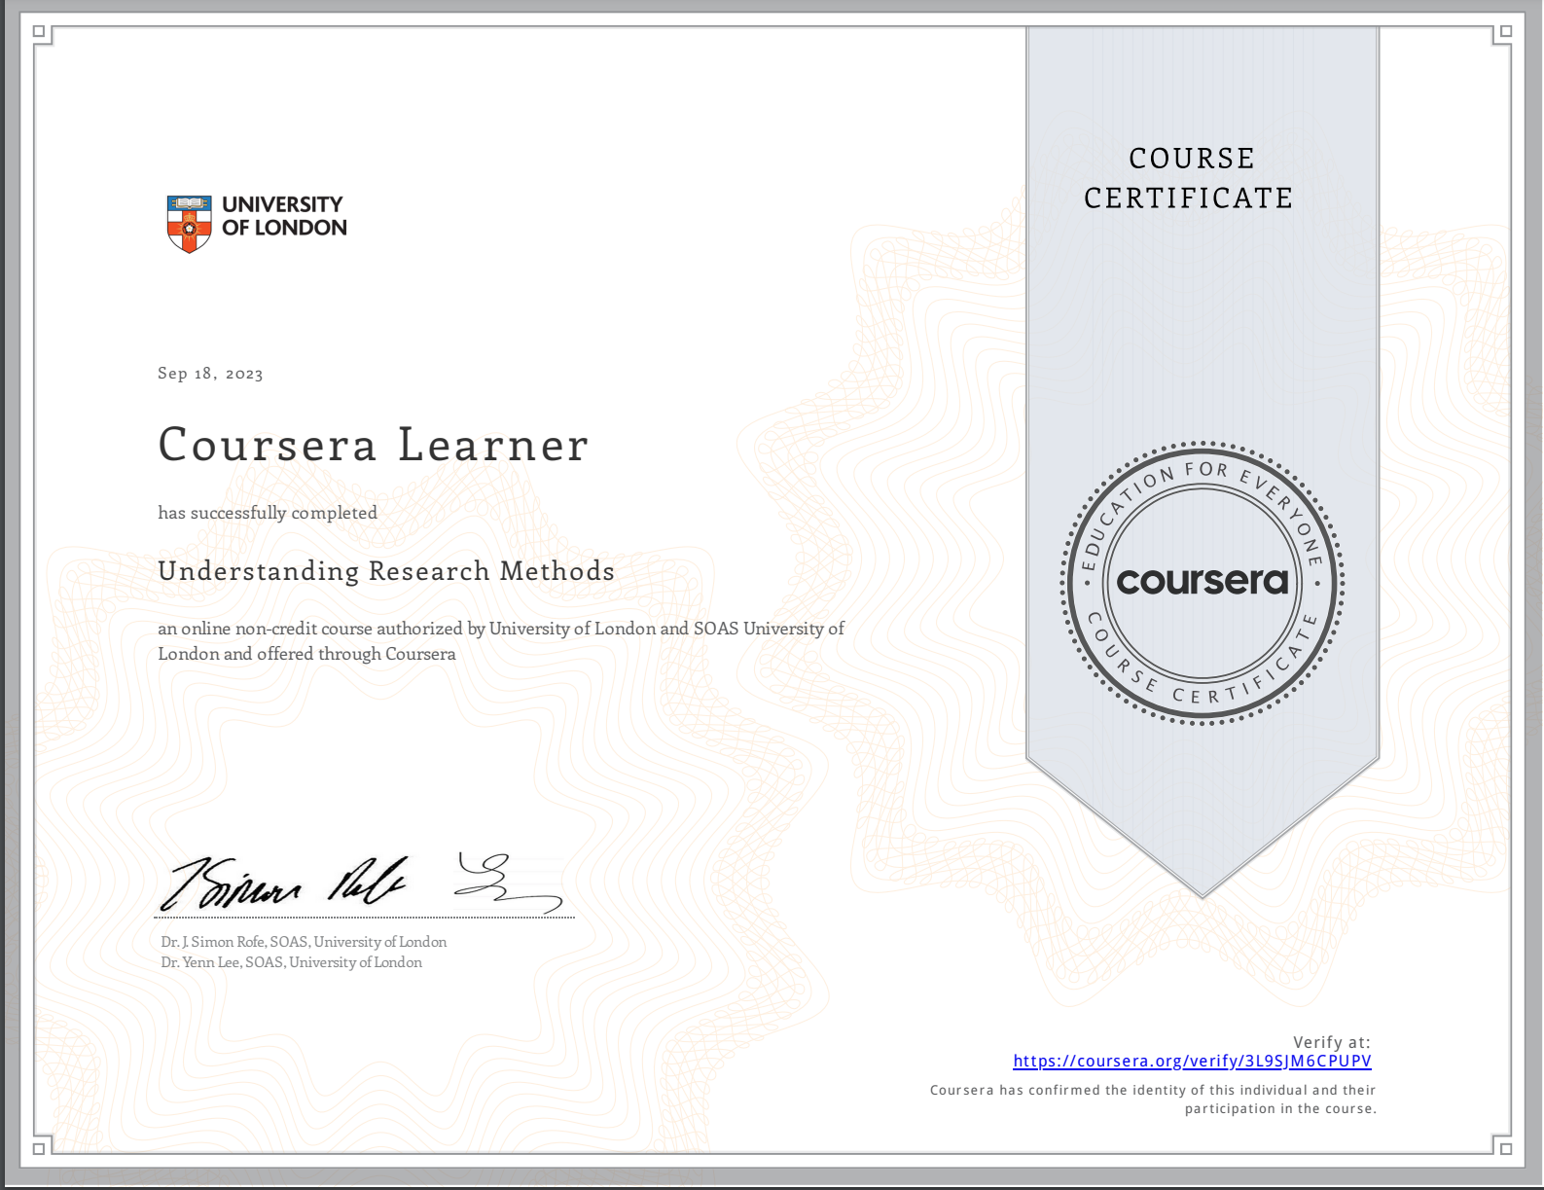
2
Week 2 - Log
1/2
What did you do?
Understanding Research Methods.pdf

Slide 16
2
Week 2 - Feedback
2/2
Team, individual, peer, workshop feedback
[Cedric] Your current research question seems to be good. However, you could try to narrow it down ever more, for example, by putting more focus onto one of the AI use cases within the sports industry. Action taken: changed one of my research questions from "How does and will AI affect the future job in the sports industry and how should the students and staff be prepared for this?" to "How will the AI technologies be integrated to the sports industry, particularly sports events organization?"

Slide 17
3
Week 3 - Log
1/2
What did you do?
Reflection
What goal(s) did you set for this week? - To finish the "Writing in the Sciences" course
What have you actually been able to do? I was able to finish and receive the certificate of "Writing in the Sciences" course.
What did you do? - research_proposal.pdf
How did the week go? This week felt more productive than the last one. However, I often felt a bit confused about what I should be working on at the moment.
What went well? I finally managed to finish the "Writing in the Sciences" course which took me a lot of effort and time.
What didn’t go so well? The research questions I had come up with before, turned out to be too broad and too general. Also, my literature review summary required some adjustments and citations. I had to spend quite some time trying to correct them.
What did you learn? I feel that thanks to the Writing in the Sciences course my writing skills have improved, or at least I am more aware of possible errors I can make. Also I learned the basics of Latex and how to use it in Overleaf.
What could be added as an Action point looking forward to next week? - To prepare questions for the survey and/or interview.

Slide 18
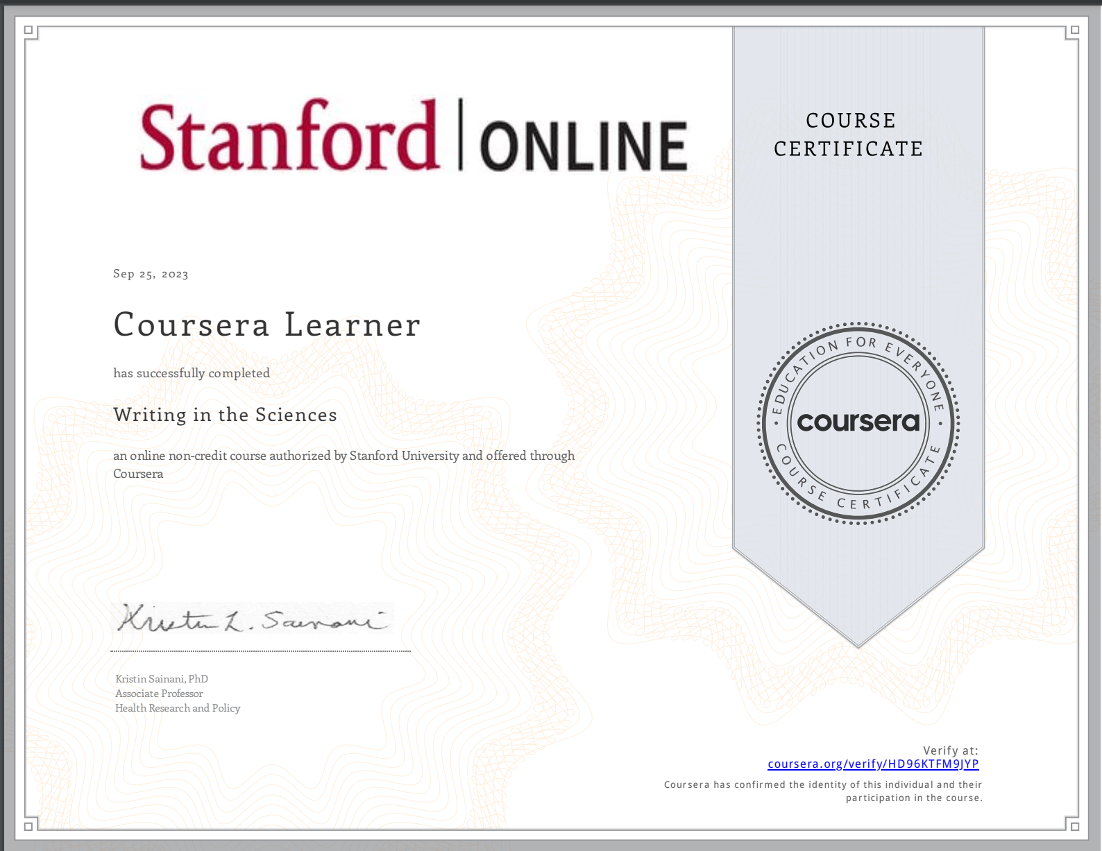
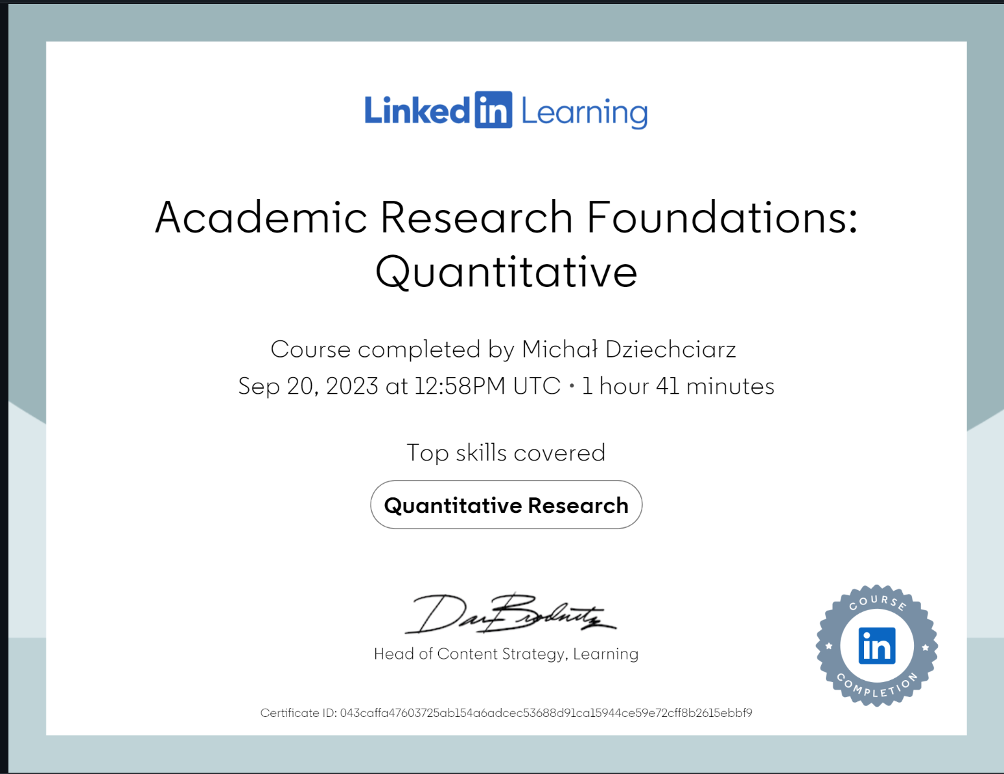
3
Week 3 - Log
1/2
What did you do?
Writing in the Sciences.pdf
Academic Research Foundations Quantitative.pdf

Slide 19
3
Week 3 - Feedback
2/2
Team, individual, peer, workshop feedback
[Reviewer] Feedback
Response

Slide 20
4
Week 4 - Log
1/2
What did you do?
Reflection
What goal(s) did you set for this week? - To prepare questions for the survey and/or interview.
What have you actually been able to do? - We created our first draft of the survey and handed it in for feedback. - However, we still need to come up with questions for the interviews.
What did you do? - Data Storage Protocool.pdf - DMP_5-7.docx
How did the week go? I feel that this week was not best, but also I can't say it was very bad.
What went well? I've found a student from the sports and esports subdomain that is willing to give me an interview.
What didn’t go so well? I had difficulties preparing the Data Management Plan, as I didn't fully understand it. Also, I struggled with finding the right outline for the Data Storage Protocol.
What did you learn? The completion of the Academic Research Foundations Quantitative course enhanced my quantitative research skills and expanded my knowledge in that field.
What could be added as an Action point looking forward to next week? - Prepare interview questions - Finalize the survey

Slide 21
4
Week 3 - Log
2/3
What did you do?
Academic Research Foundations Quantitative.pdf

Slide 22
4
Week 4 - Feedback
3/3
Team, individual, peer, workshop feedback
[Myrthe] For each of your SMARTER goals, you should create a separate slide and explain how it complies with each of the SMARTER requirements (such as being measurable, relevant, etc.). Action taken: Redesigned my SMARTER goals. Each goal now is detailed on a separate page.

Slide 23
5
Week 5 - Log
1/2
What did you do?
Reflection
What goal(s) did you set for this week? - Prepare interview questions - Finalize the survey
What have you actually been able to do? - I helped with preparing and finishing the interview questions - I implemented the survey questions into the parent survey
How did the week go? This week went relatively well. As a team, we finalized our survey and prepared the interview questions which seemed to be a time-consuming task before.
What went well? I managed to merge our survey and the parent survey without any problems and we were the first team to do so successfully.
What didn’t go so well?
What did you learn? I learned how to create conditional logic in Qualtrics. I familiarised myself with the basics of R, such as vectors, matrices and dataframes.
What could be added as an Action point looking forward to next week? - Finish all the DataCamp courses from the Inferential Statistics: A Primer module - Prepare the final outline of my research paper

Slide 24
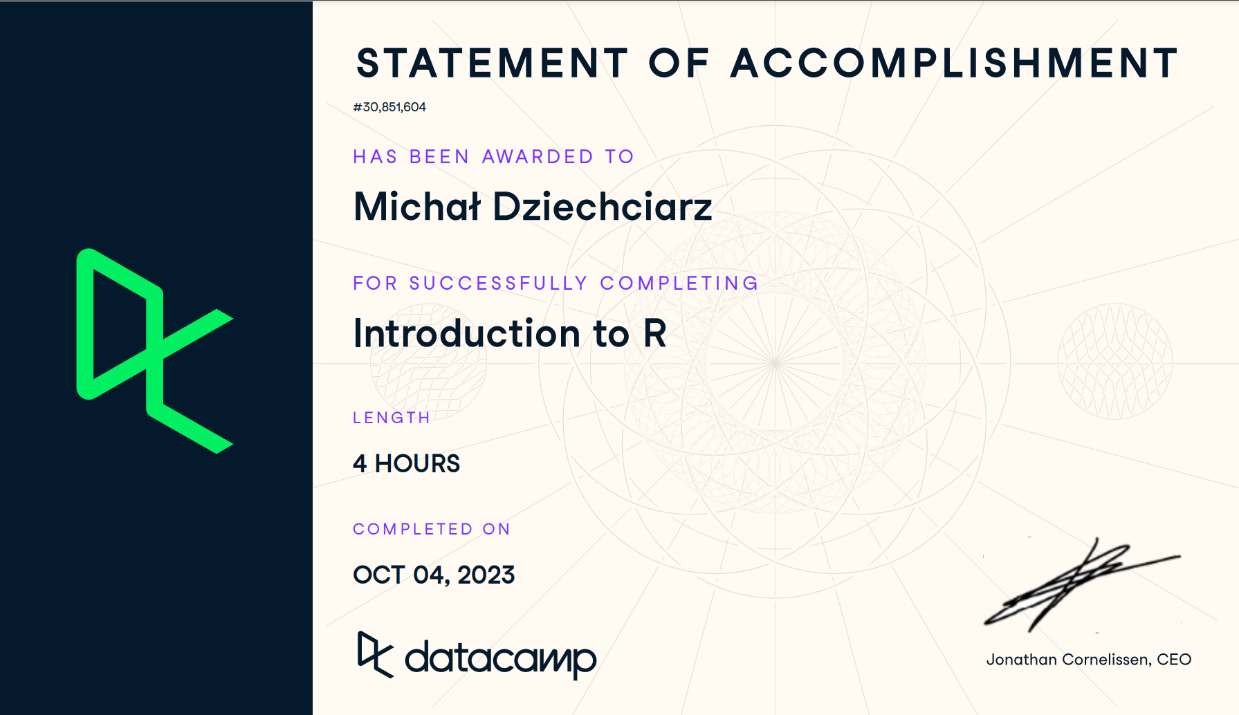
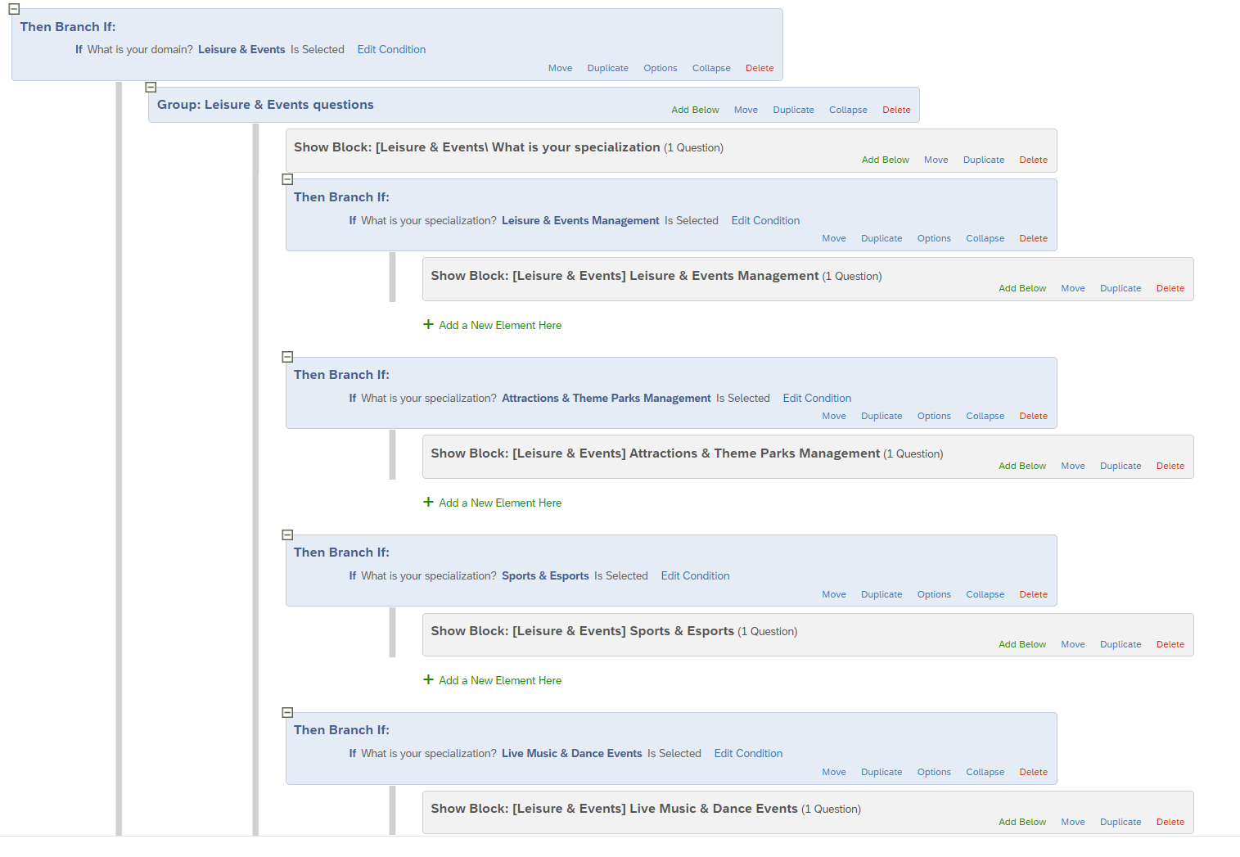
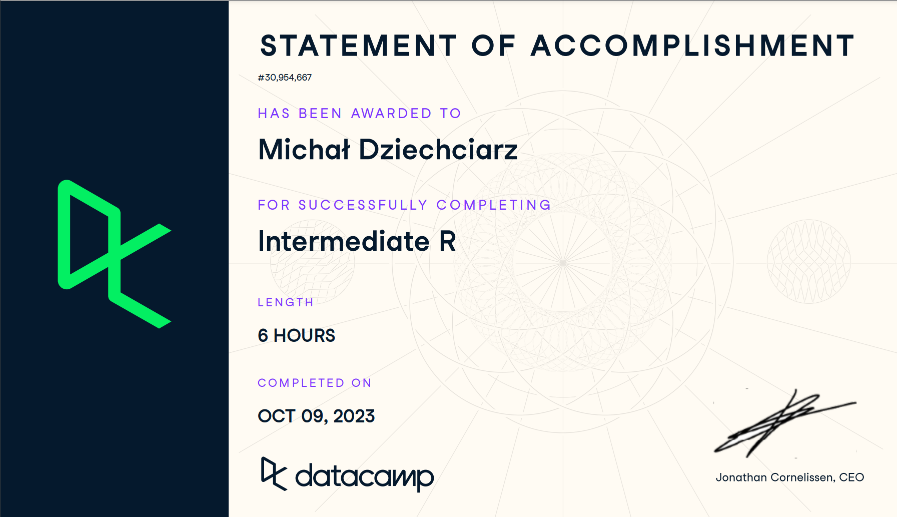
5
Week 5 - Log
2/2
What did you do?
Introduction to R.pdf
Integrated survey questions
Intermediate R.pdf

Slide 25
5
Week 5 - Feedback
2/2
Team, individual, peer, workshop feedback
[Reviewer] Feedback
Response

Slide 26
6
Week 6 - Log
1/2
What did you do?
Reflection
What goal(s) did you set for this week? - Finish all the DataCamp courses from the Inferential Statistics: A Primer module - Prepare the final outline of my research paper
What have you actually been able to do? - I was able to finish all the remaining DataCamp courses. The evidence can be found on the following pages. - I prepared the paper outline and it looks as follows: Abstract, Introduction, Literature Review, Hypotheses, Methods, Discussion, References
How did the week go? The week went fairly well overall. I focused mainly on completing the remaining Datacamp courses on Statistics, Probability, Sampling, and Hypothesis Testing in R.
What went well? I was able to finish all those courses this week, which means my mind can now my mind can be focused solely on writing my research paper and finishing the project.
What didn’t go so well? After the Statistics course, I started facing difficulties in grasping the material. After spending some extra time, I was able to complete the DataCamp assignments, but I feel that I haven't really taken much out of them.
What did you learn? This week I kept developing my R skills and learned how to perform statistical and probabilistic analysis.
What could be added as an Action point looking forward to next week? - Start writing the research paper. Finish the Methods section.

Slide 27
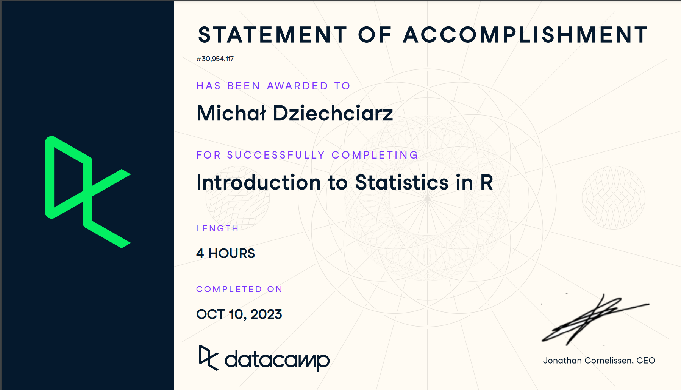
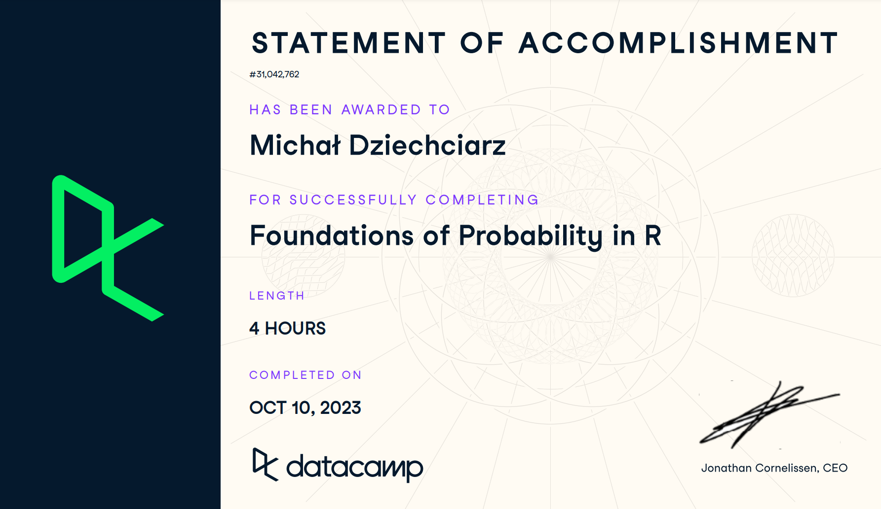
6
Week 6 - Log
2/2
What did you do?
Introduction to Statistics in R.pdf
Foundations of Probability in R.pdf

Slide 28
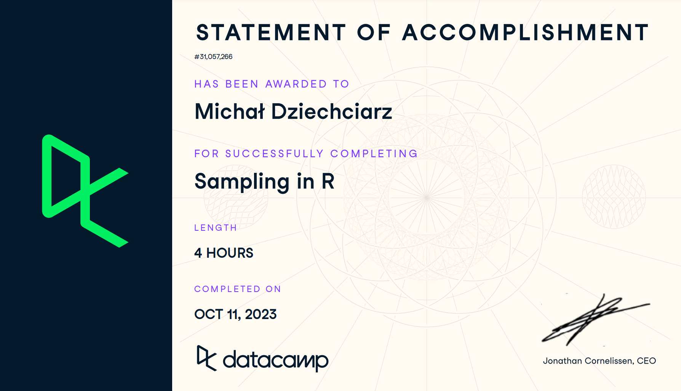
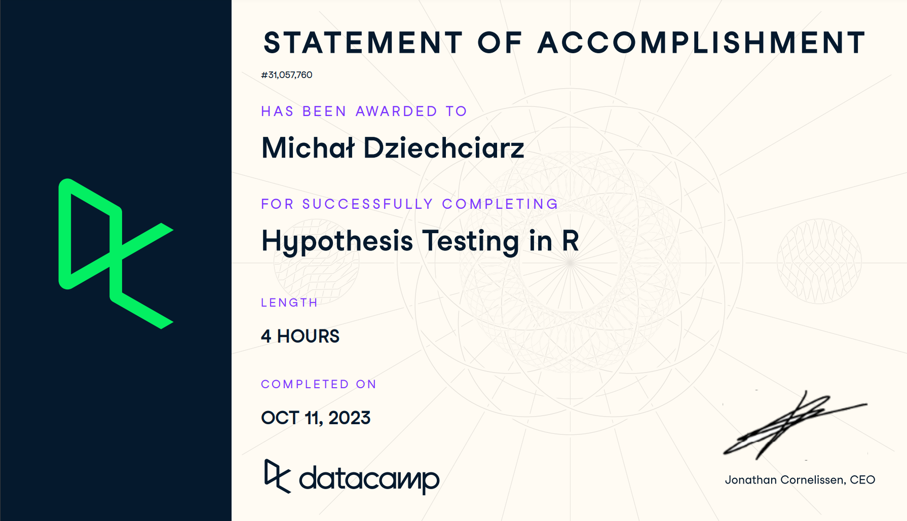
6
Week 6 - Log
2/2
What did you do?
Sampling in R.pdf
Hypothesis Testing in R.pdf

Slide 29
6
Week 6 - Feedback
2/2
Team, individual, peer, workshop feedback
[Francisco] Instead of recording your interview with a voice recorder and using an external AI tool to transcribe it, schedule a call on Microsoft Teams and then use it during your interview to record it. Action taken: Recorded my interviews with Microsoft Teams and recommended it to others

Slide 30
7
Week 7 - Log
1/2
What did you do?
Reflection
What goal(s) did you set for this week? - Start writing the research paper. Finish the Methods section.
What have you actually been able to do? - I almost finished the Methods section. All that still needs to be done is completing the last paragraphs of the Procedure subsection
Showcase the evidence of your progress (production artifacts, short descriptions-links-pictures animated gifs, etc.) - EDA - Interview transcripts
How did the week go? This week was quite busy for me as I focused on starting my research paper and specifically worked on writing the "Methods" section. I also aimed to perform a T-test to analyze the differences between students and staff.
What went well? The progress on my research paper went well. I have almost finished my Methods section. I created visualizations of measured acceptance and shared them with my team. Also, I finished my last interview and now I'm ready to perform the thematic analysis.
What didn’t go so well? I was unable to perform the t-test to compare the metrics of students and staff as the number of responses for BUas staff was too low. Because of the error that kept showing up, I lost definitely too much time.
What did you learn? I learned how to create various types of chart using ggplot2 library.
What could be added as an Action point looking forward to next week? - Finish all the deliverables - Fill in Worklog, Learning Log and Peer Review

Slide 31
7
Week 7 - Feedback
2/2
Team, individual, peer, workshop feedback
[Reviewer] Feedback
Response

Slide 32
8
Week 8 - Log
1/2
What did you do?
Reflection
What goal(s) did you set for this week? - Finish all the deliverables - Fill in Worklog, Learning Log and Peer Review
What have you actually been able to do? Everything finished and submitted :)
Showcase the evidence of your progress (production artifacts, short descriptions-links-pictures animated gifs, etc.) - EDA - Research paper
How did the week go? Surprisingly, this week went really well. I could feel strong pressure due to the approaching deadline, however, it only motivated me to work hard to successfully finish all the deliverables.
What went well? I was able to create the Linear Regression models relatively easily and I didn't encounter any major problems. Also, I was able to finish the "Results" and "Discussion" sections of my research paper without any distractions, which I usually stumble upon making the whole process much longer.
What didn’t go so well? I've had many difficulties moving my research paper from Word document into LateX. Specifically, I struggled with embedding the chart figures as they didn't show up where they should. However, I asked for help of my teammates and solved that issue.
What did you learn? - Manipulating the position of figures in LateX, and importing new packages (such as "float") - Performing correlational analysis in R

Slide 33
8
Week 8 - Feedback
2/2
Team, individual, peer, workshop feedback
[Myrthe] It is fine if you can't perform your T-tests due to a low amount of staff responses in the survey, however, you should mention that in your research paper. Action taken: Mentioned the following problem in the Limitations section of my research paper

Slide 34
Section C
C
Progress
Intended Learning Outcomes
Notes:
MUST BE COMPLETED IN WEEK 8, BUT SHOULD BE UPDATED REGULARLY
This is where you link your evidence to each of the Intended Learning Outcomes of this block.

Slide 35
ILO 1
1
Professional Practice
The student demonstrates professional behavior as well as accountability and ethics in the application of industry best practices for planning, communication, collaboration, and responsible execution of work assignments.

Slide 36
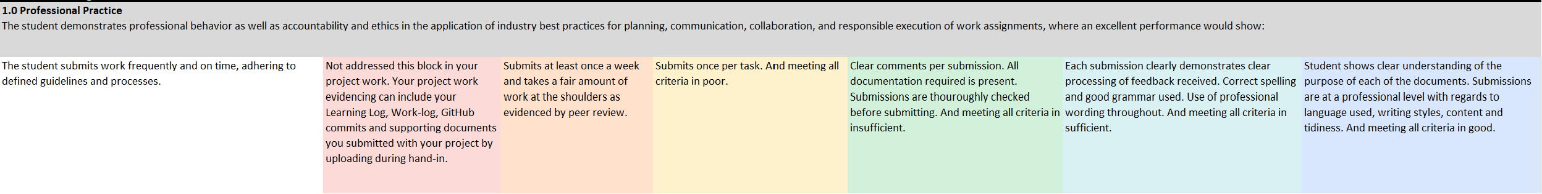





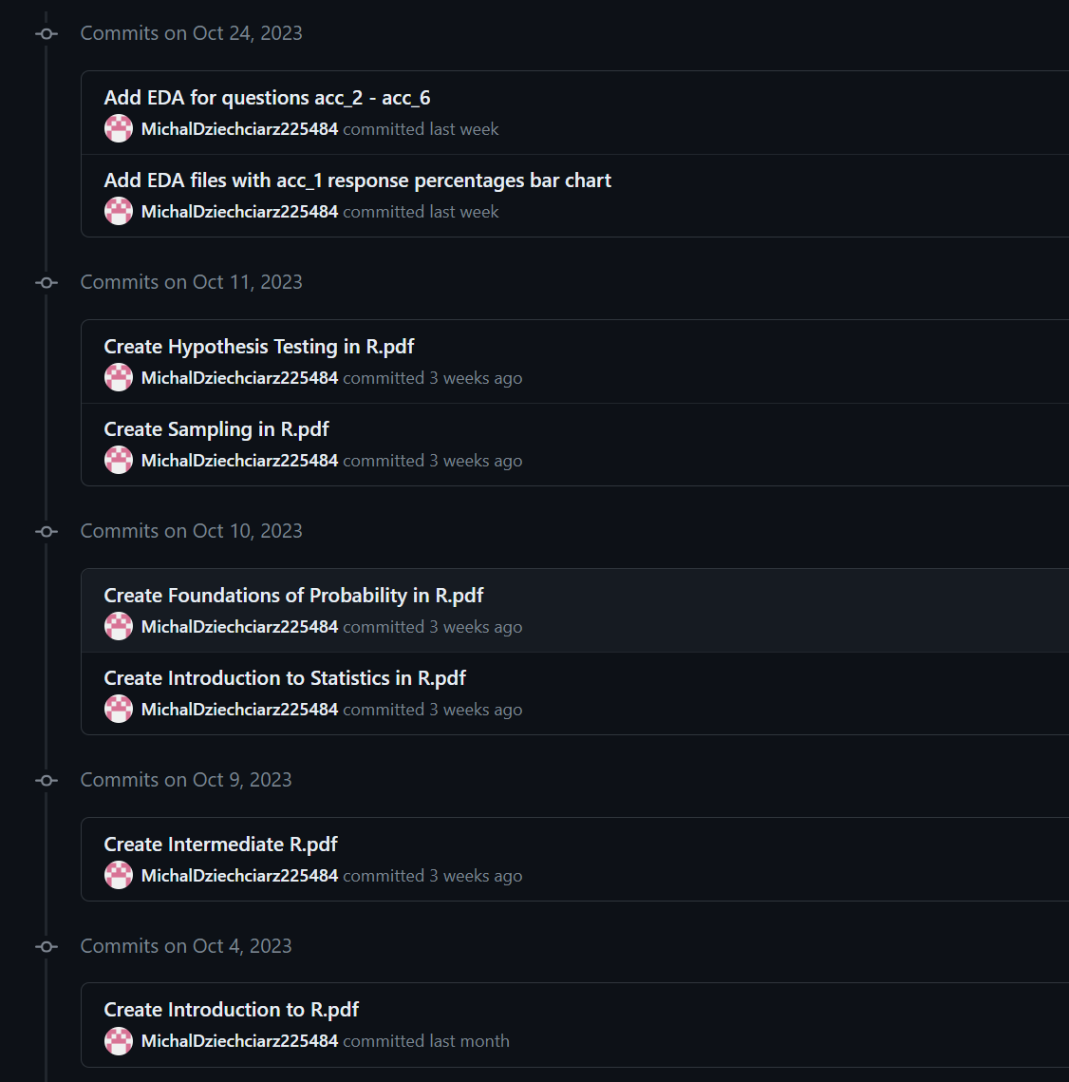
ILO 1
Professional Practice
The student demonstrates professional behavior as well as accountability and ethics in the application of industry best practices for planning, communication, collaboration, and responsible execution of work assignments.
3/4
1.0
The student submits work frequently and on time, adhering to defined guidelines and processes.
Show your best examples, do not go overboard, add in short description, you are free to alter this layout (or add slides per evidence) to suit your needs. Just be sure that it is clear.
I took fair amount of work within my team and submitted my work at least once a week as it can be seen on my Personal GitHub Repository and Team Repository.
I submitted once per task, subdeliverable and knowledge module as it can be seen in my team's Trello board and Personal GitHub Repository.
All of my commits are named/commented clearly. I regularly asked my teammates for peer-review to proof-read my work before submission.
I planned feedback sessions with my mentor every other week, noted the feedback received as it can be seen in my learning log and Trello board, and improved my work based on it.
I ensured the professional level of each of my submissions by utilizing grammar-checking tools for writing and a code-formatter for my R scripts.

Slide 37
ILO 2
2
Personal Development
& Academic Practice
The student demonstrate self-exploration and personal development, good academic practices in learning how to learn and the acquisition of professional knowledge through research,
study, analysis, applied practice, discussion and reporting.

Slide 38
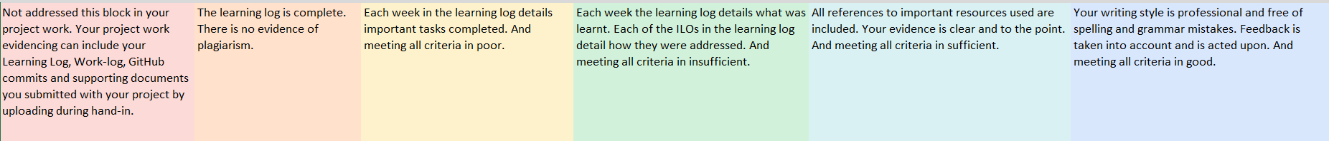
ILO 2
Personal Development & Academic Practice
The student demonstrate self-exploration and personal development, good academic practices in learning how to learn and the acquisition of professional knowledge through research, study, analysis, applied practice, discussion and reporting.
4/4
2.0
The student reports on learning progress and updates plans in a well-written, concise format with appropriate visual communication, guided by active engagement with feedback.
My learning log is complete, and I filled it in by myself.
At the end of each week, I set important tasks that should be done the next week.
Each week, in my learning, I explain what I have learned and/or discovered. Each of the ILOs detail how they have been addressed.
All the important resources for this block, such as e.g. course certificates have been evidenced in my Learning Log in the appropriate weeks.
To ensure a professional writing style I proof-read my work and used tools such as Grammarly to detect any mistakes. Any feedback I received can be seen in the feedback pages every week in my learning log. It also includes the steps I took to act upon it.

Slide 39
ILO 3.1
3
Digital Transformation 1
The student is able to demonstrate the ability to effectively conduct stakeholder analysis and utilize its findings to inform, and shape the definition of their research project and transform this into policy recommendations.

Slide 40
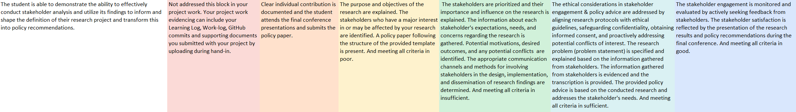
ILO 3
Digital Transformation 1
The student is able to demonstrate the ability to effectively conduct stakeholder analysis and utilize its findings to inform, and shape the definition of their research project.
1/1
3.1
The student is able to demonstrate the ability to effectively conduct stakeholder analysis and utilize its findings to inform, and shape the definition of their research project.
EXCELLENT
I was the main person responsible for writing the Stakeholder Analysis section in our Policy Paper. The Policy Paper is submitted and can be found here: Policy_paper_Leisure___Events_Management (4).pdf
Policy paper Leisure & Events Management.zip
The purpose and objectives of the research are explained in the summary and introduction sections of the Policy Paper, as well as my research paper. All the major stakeholders are listed. The policy paper follows the template provided.
The stakeholders's importance, influence, needs, expectations, motivations, concerns and potential confilcts are explained. Check the Policy Paper
Check the Policy Paper, Ethical and Legal Considerations section, Stakeholder Analysis section, - BUas Research Ethics Review Application Form-H.docx
Interview transcripts
Research information letter.pdf
Informed Consent Form.docx
FAIR_checklist.md
We actively sought feedback from the stakeholders, conducted multiple meetings with the Linking Pin, as well as with the team mentor.
The effects of our cooperation with the stakeholders was presented at the final conference in form of a poster.

Slide 41
ILO 3.2
3
Digital Transformation 2
The student is able to explain and contrast the different aspects of the investigated use-case by means of a research proposal and formulate research questions and consequently, hypotheses which can be tested.

Slide 42
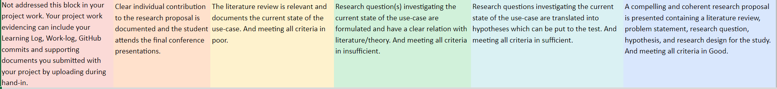
ILO 3
Digital Transformation 2
The student is able to demonstrate the ability to effectively conduct stakeholder analysis and utilize its findings to inform and shape the definition of their research project and transform this into policy recommendations.
1/1
3.2
The student is able to demonstrate the ability to effectively conduct stakeholder analysis and utilize its findings to inform and shape the definition of their research project and transform this into policy recommendations.
EXCELLENT
My contribution to the Research Proposal can be seen especially In the Introduction and Domains sections. I attended the final conference presentations.
The literature review of my research paper is relevant to the topic of AI in the Leisure and Events domain, especially sports industry, and indicates the need for further research
My research questions are presented both in the Research Proposal, as well as in the Hypotheses section of my Research Paper.
The hypotheses which are later tested by t-tests can be found in the Hypotheses section of my Research Paper.
Check Research Proposal

Slide 43
ILO 4.1
4
Research Methodology​
The student is able to identify, select, and implement appropriate quantitative and qualitative research designs to address their research questions.​

Slide 44
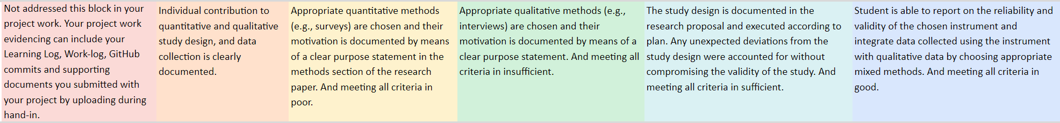
ILO 4
Research Methodology​: Study Design
The student is able to identify, select, and implement appropriate quantitative and qualitative research designs to address their research questions.​
1/1
4.1
The student is able to identify, select, and implement appropriate quantitative and qualitative research designs to address their research questions.​
I was involved in designing the questions for the Leisure and Events part of the survey, and I was the main person responsible for integrating it to the parent survey. Also, I performed 2 individual interviews - evidenced by Interview transcripts
Appropriate quantitative methods are chosen. We chose Qualtrics survey, and the motivation with a clear purpose can be found in the methodology section of my research paper.
Appropriate qualitative methods are chosen. We opted for semi-structured interviews. The motivation with a clear purpose can be found in the methodology section of my research paper.
The design is documented in the research proposal. In my research paper, I discuss the limitations of the research. The research was carried out according to plan where possible, and where not, it was mentioned in the limitations section.
Place holder

Slide 45
ILO 4.2
4
Research Methodology​
The student is able to develop and implement appropriate data management methods, integrating legal and ethical concerns to facilitate their study design.​

Slide 46
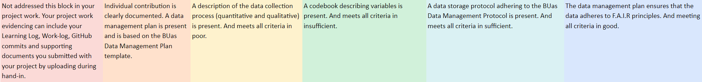
ILO 4
Research Methodology: Data Management
The student is able to develop and implement appropriate data management methods, integrating legal and ethical concerns to facilitate their study design.​
1/1
4.2
The student is able to develop and implement appropriate data management methods, integrating legal and ethical concerns to facilitate their study design.​
I was the main person responsible for creating the Data Storage Protocool. Also, I was responsible for preparing half of the Data Management Plan (My part can be found here)
The description of our data collection process can be found in the Data Collection Procedure.pdf document.
Codebook.md
describing variables is present.
Data Storage Protocool.pdf
Adhering to the BUas Data Management Protocol is present.
Our data management plan ensures that the data adheres to F.A.I.R principles as it can be seen in FAIR_checklist.md. GDPR_checklist.md

Slide 47
ILO 5
5
Decision Intelligence and Statistical inference​
The student is able to make use of appropriate statistical methods to test their hypotheses and propose the best course of action based on their analyses.

Slide 48
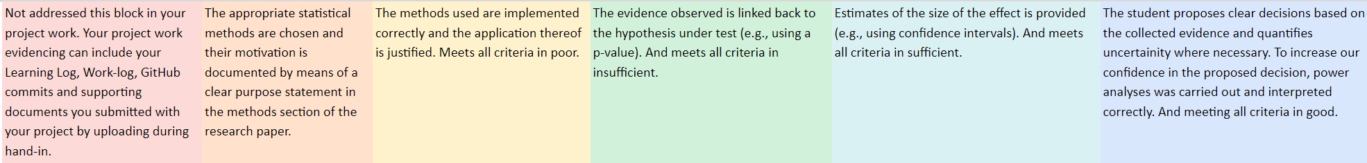
ILO 5
Decision Intelligence and Statistical inference​
The student is able to make use of appropriate statistical methods to test their hypotheses and propose the best course of action based on their analyses.
1/1
5.0
The student is able to make use of appropriate statistical methods to test their hypotheses and propose the best course of action based on their analyses.
The Methods section of my research paper describes the statistical methods chosen and the motivation behind them.
The implementation of the previously mentioned methods is described in the Methods section.
The hypotheses are tested and the results are described in the Results section. Measured p-values are presented for each of the tested hypotheses.
The confidence intervals are presented. Check correlational analysis charts (figures 6-8) and T-tests. statistical_interference.ipynb
The proposed decisions can be found both, in the recommendations section of my Research Paper, as well as the Policy Paper.

Slide 49
ILO 6
6
Scientific Reporting
The student is able to communicate findings by means of a structured, coherent, and well-argued scientific report using Latex.

Slide 50
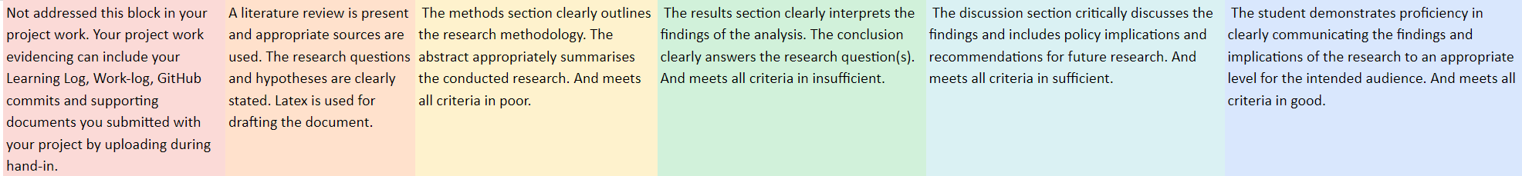
ILO 6
Scientific Reporting
The student is able to communicate findings by means of a structured, coherent, and well-argued scientific report using Latex.
1/1
6.0
The student is able to communicate findings by means of a structured, coherent, and well-argued scientific report using Latex.
The literature review as well as the research questions and hypotheses are present and the appropriate sources have been used and can be found in the reference list of my Research paper. The paper has been drafted using Latex.
Both, the methods section clearly outlining the research methodology, and the abstract summarizing the research, are present.
The results section clearly presents the results of the research and interprets them. The conclusions answer previously introduced research questions.
Paper includes the discussion section that clearly discussed the results and includes implications and recommendations subsections.
The findings are communicated clearly through the implications subsection of my discussion section and are written appropriately for the intended audience.

Slide 51

Medal Challenges
Going the extra mile!

Slide 52
Medal Challenges
Going the extra mile!
1/1
Put your evidence down here to receive a medal!
Show your best examples, do not go overboard, add in short description, you are free to alter this layout (or add slides per evidence) to suit your needs. Just be sure that it is clear.

Slide 53
Section D
D
Reflection
Notes:
MUST BE COMPLETED IN WEEK 8
Summative reflection on your progress during the block including a critical assessment of everything you did and learned during the block. This is a comprehensive review of everything recorded in Section B, evaluated against the goals and planning laid out in Section A.

Slide 54
D
What did I achieve this block?
1/2
My most significant achievements this block
Overcoming my fear of approaching/interviewing new people. Performing in the decisive moment, when the pressure is at its peak.
My most difficult challenges this block
Planning my work and staying motivated when not seeing clearly the target goal of the assignment.
The most important lessons I learned
When facing difficulties and not understanding the assignment, I should not hesitate to ask for help or additional explanations. Asking a couple of questions is not much of an effort, and it will make me feel much more confident with the work I am supposed to do.

Slide 55
D
How well am I progressing?
2/2
Reflection on my self assessment My self assessment grade is a
x.x
How I plan to improve next block
Asking more questions.

